Slide 1
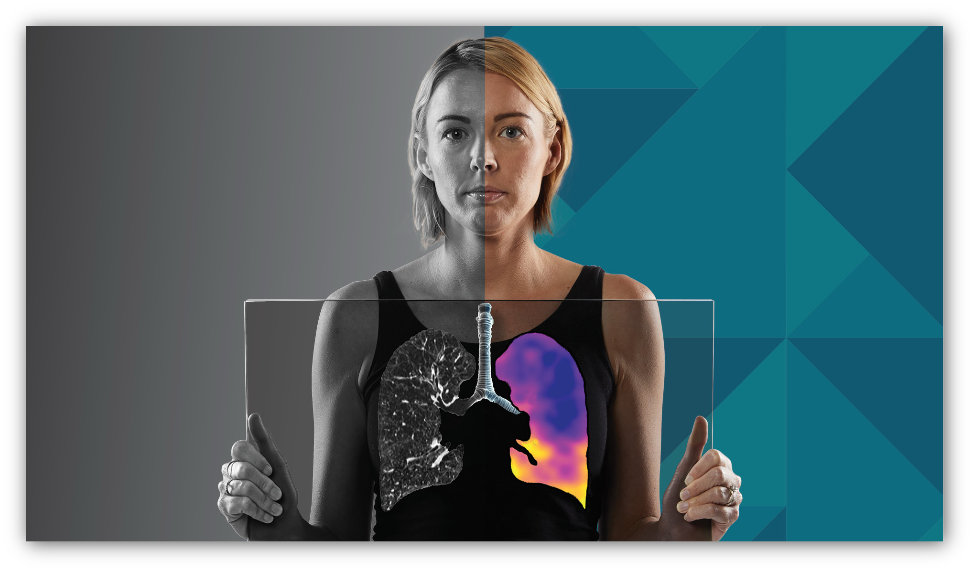



4DMedical Limited (ASX:4DX)
Annual General Meeting
30 October 2025
Leading Cardiopulmonary Imaging into the Next Era
Copyright © 4DMedical Limited 2025
Level 7, Melbourne Connect
700 Swanston Street
Melbourne, Victoria 3053
Australia
ABN 31 161 684 831
www.4dmedical.com

Slide 2

Disclaimer
This presentation has been prepared by 4DMedical Limited (ACN 161 684 831) (Company or 4DMedical). This presentation contains summary information about the Company, its subsidiaries and the entities, businesses and assets they own and operate (Group) and their activities current as of 30 October 2025 unless otherwise stated and the information remains subject to change without notice. This presentation contains general background information and does not purport to be complete. No attempt has been made to independently verify the information contained in this presentation.
Not an offer or financial product advice
The Company is not licensed to provide financial product advice. This presentation is not and should not be considered, and does not contain or purport to contain, an offer or an invitation to sell, or a solicitation of an offer to buy, directly or indirectly, any securities to any person in any jurisdiction to whom or in which such offer or solicitation is unlawful nor shall it (or any part of it), or the fact of its distribution, form the basis of, or be relied on in connection with or act as any inducement or recommendation to enter into, any contract whatsoever relating to any securities.
This presentation is for information purposes only and is not a prospectus, product disclosure statement, pathfinder document for the purposes of section 734(9) of the Australian Corporations Act 2001 (Cth) (Corporations Act) or other offer document under Australian law or the law of any other jurisdiction. This presentation does not constitute an invitation to apply for or purchase securities and does not include any application form for securities. This presentation does not constitute an advertisement for an offer or proposed offer of securities. Neither this presentation nor anything contained in it shall form the basis of any contract or commitment and it is not intended to induce or solicit any person to engage in, or refrain from engaging in, any transaction. Nothing in this presentation constitutes legal, financial, tax or other advice. Recipients of the presentation should conduct their own investigation, evaluation and analysis of the business and other data and information set out in the presentation.
The distribution of this presentation in jurisdictions outside Australia may be restricted by law and you should observe any such restrictions. Any failure to comply with such restrictions may constitute a violation of applicable securities laws. In particular, this presentation may not be distributed or released in the United States. The securities in the Company (Securities) have not been, and will not be, registered under the U.S. Securities Act of 1933, as amended (U.S. Securities Act), or the securities laws of any state or other jurisdiction of the United States. Accordingly, the Securities may not be offered or sold, directly or indirectly, in the United States, unless they have been registered under the U.S. Securities Act (which the Company has no obligation to do or procure) or are offered or sold in a transaction exempt from, or not subject to, the registration requirements of the U.S. Securities Act and applicable securities laws of any state or other jurisdiction of the United States.
4DMedical Limited (ASX:4DX) October 2025

Slide 3
Agenda
Opening & introductions
Chair’s address
CEO’s address
Procedural matters
Formal business
Closing remarks
4DMedical Limited (ASX:4DX) October 2025

Slide 4
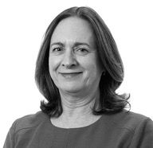
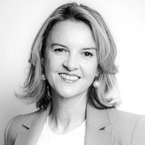

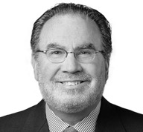
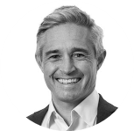
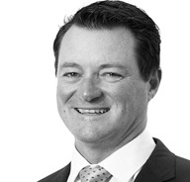
Board of Directors – significant medical and commercial sector experience
LIL BIANCHI Non-Executive Chair Chair, Audit & Risk Committee
Dr GERALDINE McGINTY MD Non-Executive Director
Internationally recognised expert in health care strategy and imaging economics, and prominent advocate for patient-centred care. Professor of Radiology and Population Health Sciences at Weill Cornell Medicine in New York City.
Experienced contributor of business transformations for US listed technology companies with a beneficial technology product expertise in AI and SaaS offerings.
Dr ANDREAS FOURAS PhD Managing Director and CEO
Dr ROBERT A. FIGLIN MD Non-Executive Director Chair, Medical Advisory Committee
Award-winning aerospace engineer and innovator responsible for the conception and development of 4DMedical’s core technologies.
Globally recognised leader in genitourinary and thoracic oncology, as well as Editor of the Kidney Cancer Journal and Spielberg Family Chair in Hematology/Oncology at Cedars Sinai.
JULIAN SUTTON Non-Executive Director Chair, Remuneration & Nomination Committee
JOHN LIVINGSTON Non-Executive Director
Founding partner of ASX listed Integral Diagnostics (ASX:IDT) and an industry leader in the implementation of PACS and RIS in radiological settings.
Chartered Financial Analyst who began his career as an actuarial analyst in Melbourne before moving into funds management with Schroders and Credit Suisse in London.
4DMedical Limited (ASX:4DX) October 2025

Slide 5

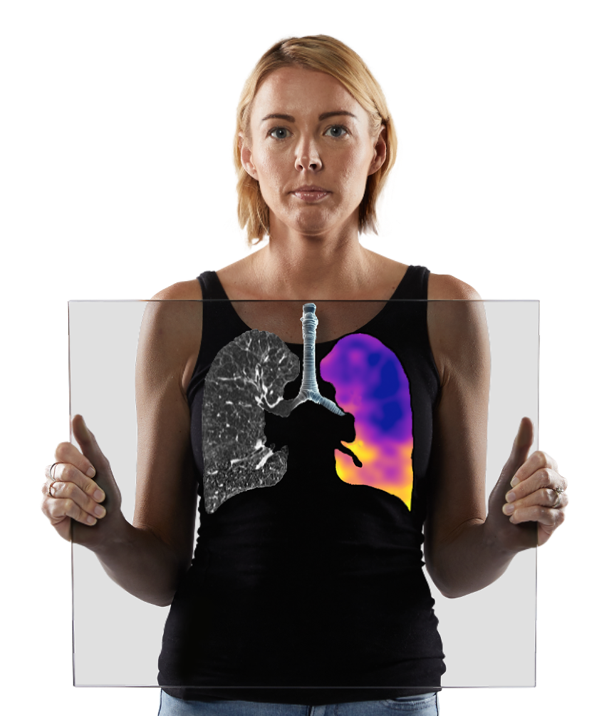
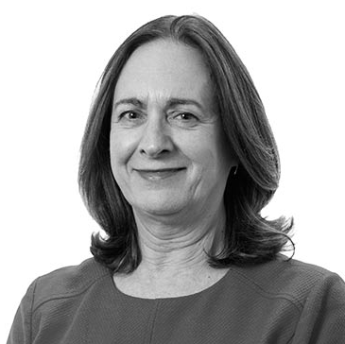
Chair’s address
Lil Bianchi Non-Executive Chair

Slide 6
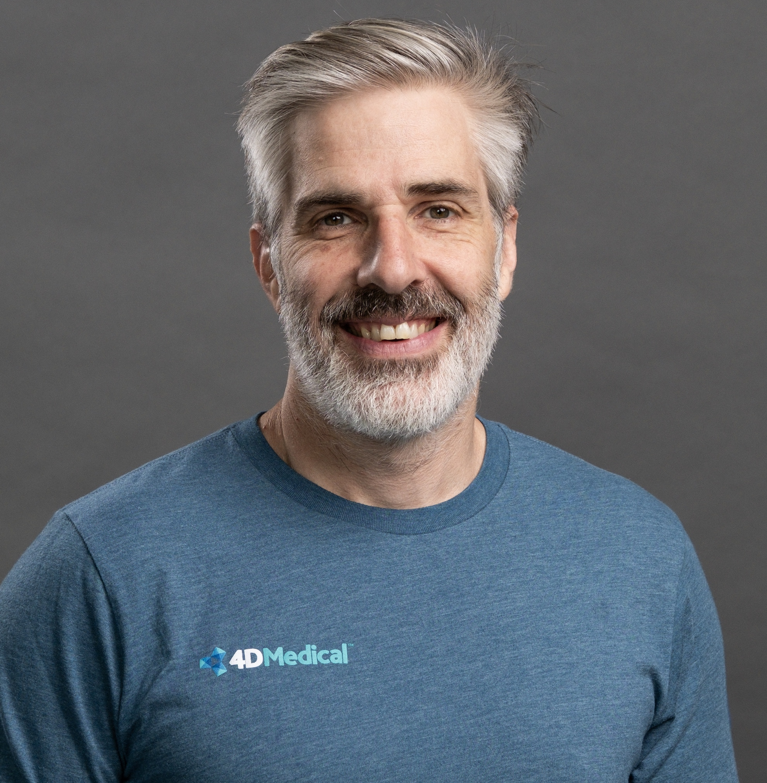
CEO’s address
Dr Andreas Fouras PhD Managing Director & CEO

Slide 7


Who is
The leading pulmonary & cardiothoracic imaging software company in the market
Structural & Functional Imaging software
100+ patented technologies
9 FDA cleared devices
130 global team members
US Go-To-Market | AU Engineering, R&D and support
Technical & clinical expertise
Global brands supporting distribution
4DMedical was founded in Melbourne in 2013 to bring breakthrough lung function imaging technologies to patient care. Listed on the ASX in 2020. In Dec. 2023, we acquired USA-based Imbio, Inc. to combine our unique structural and functional image analysis expertise.
Revenues and GTM teams heavily US focused
4DMedical Limited (ASX:4DX) October 2025

Slide 8
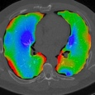
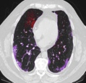
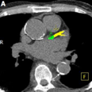
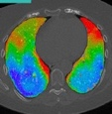
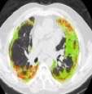
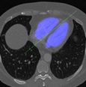
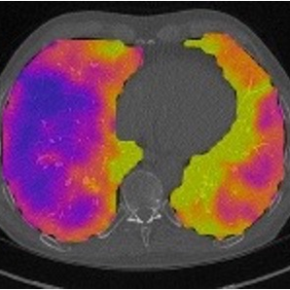
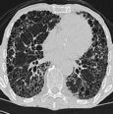
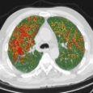
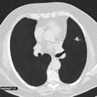
Portfolio
Pulmonary Function
Pulmonary Structure
Cardiovascular
Lung Density
Emphysema, HAA, Fissures
XV LVAS®
Dynamic Ventilation Analysis (Fluoro)
FDA/CE
CAC
Coronary Calcification
FDA
FDA/CE
CT LVAS™
CT-based Ventilation Analysis
FDA
Lung Texture
ILD’s / Fibrosis
CE
PHA
Hypertension (RV/LV, MPA, Pa/Ao)
FDA/CE
CT:VQ™
Next Gen VQ (Ventilation + Perfusion)
IQ-UIP™
IPF Screening
FDA
FDA
Functional LDA
Air Trapping + Emphysema
FDA/CE
FDA/CE
Lung Nodules
Lung Cancer (Partner Solution)
4DMedical Limited (ASX:4DX) October 2025

Slide 9
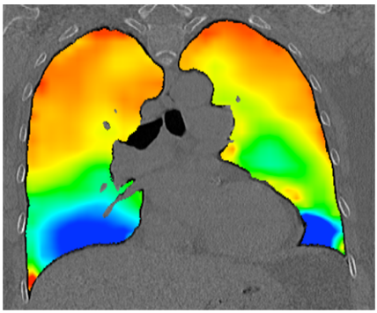
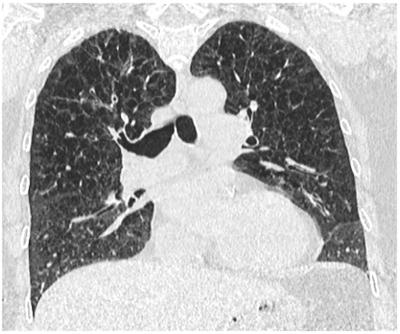
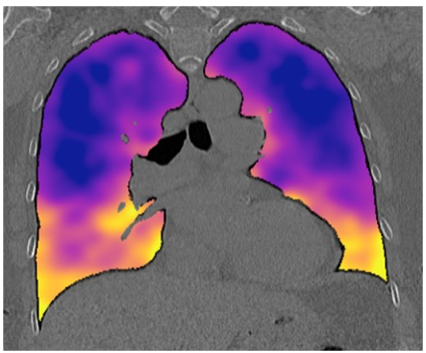
CT:VQ™ All the CONTRAST. None of the INJECTIONS.
Value-adding the standard-of-care Chest CTs with Non-contrast functional imaging
CT:VQ™ Non-contrast Ventilation & Perfusion
Routine CT
Clinical Value
4DMedical Limited (ASX:4DX) October 2025

Slide 10
CT:VQ™ FDA Clearance
Transformational Milestone - CT:VQ™ becomes the world’s first and only non-contrast, CT-based ventilation-perfusion imaging technology to receive FDA 510(k) clearance.
Large Addressable Market - Over 1M VQ scans annually in the U.S.; USD $1.1B+ U.S. market, USD $2.6B+ global opportunity. Introduction of CT:VQ™ into the market will drive long-term growth in demand for ventilation-perfusion scans beyond the traditional nuclear VQ indications.
Instant Scalability - Compatible with 14,500 CT scanners in the U.S., enabling broad adoption without new infrastructure.
CT:VQ™ poised to displace nuclear VQ scans and expand functional lung imaging
Clinical Validation studies submitted as part of FDA 510(k)
Commercial Traction underway with pre-clearance sites already converting to commercial contracts
4DMedical Limited (ASX:4DX) October 2025

Slide 11
Key commercial, product & clinical milestones: FY25 to date
FDA clearance for CT:VQ™
(U.S. Food and Drug Administration), the world’s first lung ventilation and prefusion software imaging tool, coupled with U.S. Reimbursement for CT:VQ™ from the U.S. Centers for Medicare and Medicaid Services (CMS) at US$650.
Stanford University becomes the first U.S. Academic Medical Centre (AMC) to adopt CT:VQ™ under a commercial contract, 6-weeks post-clearance.
U.S. Department of Defense (DoD) contract to supply CT:VQ™ scans to assess lung health in a cohort of active-duty personnel.
Contract wins and renewals
Across multiple market segments and key reference sites globally, displaying increased commercial momentum and uptake of 4DMedical’s SaaS products.
4DMedical partners with AstraZeneca and Spectrum Medical Imaging to perform Lung Health Screening in Brazil and Australia, respectively.
Strategic partners
Strategic investment from industry partner Pro Medicus Limited, strengthening balance sheet and unlocking distribution opportunities.
4DMedical signs reseller agreement to have Philips as an authorised reseller throughout the U.S., representing a transformative commercial pathway for 4DMedical's product suite, leveraging Philips' long established and significant commercial partnerships.
Key evidence & clinical publications
Multicentre trial involving U.S. Veterans, published in Respiratory Research, revealed unique functional biomarker signatures of early and subtle forms of small airways disease that are often missed by standard tests like spirometry and CT scans
4DMedical Limited (ASX:4DX) October 2025

Slide 12



Commercialisation Strategy
US Government
US Commercial
Global Partnerships
Australia
Enablers
Olympus
I-MED
Exclusive
Non-exclusive
AstraZeneca
Integral Diagnostics
Reimbursement
Nuance/Aidoc
Jones, PRC, Spectrum
Sector
Veterans Affairs
Community-based Clinics
Global Pharma Companies
Community Clinics
Department of Defense
Academic Institutes
Global Device Companies
Radiology Networks
Federal & State Facilities
Health Systems (IDN’s)
AI Marketplace Companies
Public Hospitals
Radiology Networks
National Programs
Rationale
Unmet need to solve for respiratory issues, including deployment-related respiratory diseases (DRRD)
Largest lung diagnostic market with huge economic scale
Large burden of data needed where our technologies can accelerate progress
Early adoption of core technologies in key players to build influence and scale
PACT Act - US$280 billion commitment over ten years, covers numerous respiratory illnesses as presumptive conditions. Healthcare eligibility to 3.5 million post-9/11 veterans. Bi-partisan support of veteran care. Philips has long established and significant existing partnerships
Reimbursement rates established covering 4,000 facilities. Over 14.5k CT scanners deployed.
Shortage of clinicians creates opportunity for AI tools and faster clinical insights
Custom imaging biomarker development and patient selection tools shorten clinical trial time and expense in the multi billion-dollar pharma development sector. AI marketplaces increase access and coverage through deployment capabilities
Australian radiology is innovative and readily accessible through community practices, networks and hospitals, with a high proportion of CT Scanners (33.9%) . Chest CT procedures through Medicare = 330k per annum. Proximity and collaboration with our development team speeds innovation.

Slide 13
4DMedical SaaS revenue building momentum, driven by increased fundamentals of layering growth in site numbers and scan volume, throughout FY2025
Global sites delivering 4DMedical scans
Structural & Functional Scan Analysis
Group Operating Revenue
+60%
+105%
AUD $’000
SaaS
80,000
35%
+56%
Lease
400
388
75,000
6.0
361
70,000
5.0
350
65,000
60,000
4.0
301
55,000
3.0
300
50,000
271
45,000
2.0
242
40,000
1.0
250
0
0.0
Q4 FY24
Q1 FY25
Q2 FY25
Q3 FY25
Q4 FY25
Q1 FY25
Q2 FY25
Q3 FY25
Q4 FY25
FY24
FY25
4DMedical delivering XV Technology® at 388 sites globally at 30 June 2025, growing 60% year-on-year, reflecting sustained growth across our Radiology and Hospital networks, third party distributor networks, and Olympus SeleCT™ screening sites.
4DMedical delivered 194,789 scans in FY25, with over 74,000 scans in Q4 FY25 alone, up 35% quarter-on-quarter. Significant uplift driven by the subscription-based product portfolio, notably LDAi™, LDAf™, SeleCT™ screening, IQ-UIP™ analysis, as well as research and demonstration sites.
Underlying SaaS revenue up 95% year-on-year when adjusting for contractual true-up payments, and scanner lease and maintenance income. Group operating revenue of $5.9 million, with gross margins >90%, up 56% on a reported basis.
4DMedical Limited (ASX:4DX) October 2025

Slide 14
Built the fundamentals, significant multipliers in play during 2025 and beyond
….2025
Foundations established
Multiplier #1
Philips agreement
Multiplier #2
CT:VQ™ displacing NUC:VQ
2026….
Commercialisation of comprehensive lung function portfolio established, with >$6m run-rate
Cost under control – focus on growth activities
25 x
Sales personnel
>$1b
US market opportunity
Key opinion leaders and reference sites on-boarded.
Commercial–payers, VA, DoD and AMCs activated
>25x increases sales coverage
Current activation of Agreement creates large commercial coverage across all sectors in US healthcare
Better resolution, lower cost and a more integrated approach to workflow, CT:VQTM can displace existing $1b market for NUC:VQ and grow the market through increased accessibility of CT
CMS Reimbursement granted for key products at $650 (USD)
Extensive regulatory clearances, including 9 FDA cleared products
4DMedical Limited (ASX:4DX) October 2025

Slide 15
Procedural matters

Slide 16
Formal Business

Slide 17
Items of Business
Item 1:​ | Financial Report, Directors’ Report and Auditors Report​
Item 2:​ | Remuneration Report​
Item 3:​ | Spill Resolution​
Item 4:​ | Re-election of Directors – Mr John Livingston and Mr Julian Sutton​
Item 5:​ | Proposed issue of Equity Securities to Directors – Ms Lil Bianchi, Mr John Livingston, Mr Julian Sutton, Dr Robert A Figlin and Dr Geraldine McGinty​
Item 6:​ | Proposed issue of Equity Securities to Directors in lieu of director fees – Ms Lil Bianchi, Mr John Livingston, Mr Julian Sutton, Dr Robert A Figlin and Dr Geraldine McGinty​
Item 7:​ | Grant of Options to the Managing Director and CEO​
Item 8:​ | Resolution withdrawn
Item 9:​ | Approval in respect of the Tax-Exempt Employee Share Plan​
Item 10:​ | Renewal of Proportional Takeover Provisions in Constitution​
4DMedical Limited (ASX:4DX) October 2025

Slide 18
Formal Business
Item 1: Financial Report, Directors’ Report and Auditors Report​
To receive and consider the Financial Report of the Company and its controlled entities and the Reports of the Directors and Auditor for the year ended 30 June 2025. ​
4DMedical Limited (ASX:4DX) October 2025

Slide 19
Formal Business
Item 2: Remuneration report​
To consider, and if thought fit, to pass, the following as an ordinary resolution: ​ ​ “That the Remuneration Report, as contained in the Directors’ Report for the year ended 30 June 2025, is adopted.”
In Favour​ | Against​ | Proxy Discretion​ | Abstain​
23,611,761 | 3,623,623 | 7,127,726 | 1,220,093​
68.71%​ | 10.55%​ | 20.74%​ | ​
Further Information:​ The Board unanimously recommends that Shareholders vote in favour of Item 2.​ The Chair of the meeting intends to vote undirected proxies in favour of the Item.​ The voting exclusion for this item is as disclosed in the Notice of Meeting.
4DMedical Limited (ASX:4DX) October 2025

Slide 20
Formal Business
Item 3: Spill Resolution
To consider, and if thought fit, to pass, the following as an ordinary resolution: ​ ​ That, for the purposes of section 250V(1) of the Corporations Act and for all other purposes, approval is given for: ​ (a) the Company to hold another meeting of Shareholders within 90 days of the date of this meeting (Spill Meeting); ​ (b) all Vacating Directors cease to hold office immediately before the end of the Spill Meeting; and ​ (c) resolutions to appoint persons to offices that will be vacated pursuant to (b) to be put to vote at the Spill Meeting.
In Favour​ | Against​ | Proxy Discretion​ | Abstain​
6,139,489 | 19,108,254 | 8,496,065 | 1,839,395
18.19%​ | 56.63% | 25.18%​ | ​
Further Information:​ The Board unanimously recommends that Shareholders vote against Item 3.​ The Chair of the meeting intends to vote undirected proxies against item 3.​ The voting exclusion for this item is as disclosed in the Notice of Meeting.
4DMedical Limited (ASX:4DX) October 2025

Slide 21
Formal Business
Items 4A and 4B: Re-election of Directors
Item 4A​ To consider, and if thought fit, to pass, the following as an ordinary resolution: ​ “That, for the purposes of clause 13.3(b) of the Constitution, Listing Rule 14.4, and for all other purposes, Mr John Livingston, a non-executive Director appointed on 7 March 2018 and last re-elected on 3 November 2022, retires in accordance with clause 13.3(a) of the Constitution, and being eligible, is re-elected as a Director.”
In Favour​ | Against​ | Proxy Discretion​ | Abstain​
22,804,777 | 2,781,993 | 7,241,241​ | 2,755,192
69.47%​ | 8.47%​ | 22.06%​ | ​
Item 4B​ To consider, and if thought fit, to pass, the following as an ordinary resolution: ​ “That, for the purposes of clause 13.3(b) of the Constitution, Listing Rule 14.4, and for all other purposes, Mr Julian Sutton, a non-executive Director appointed on 15 September 2017 and last re-elected on 3 November 2022, retires in accordance with clause 13.3(a) of the Constitution, and being eligible, is re-elected as a Director.”
In Favour​ | Against​ | Proxy Discretion​ | Abstain​
19,529,617 | 7,995,672​ | 7,225,874 | 832,040
56.20%​ | 23.01%​ | 20.79%​ | ​
4DMedical Limited (ASX:4DX) October 2025

Slide 22
Formal Business
Items 5A to 5E: Proposed issue of Equity Securities to Directors​
Item 5A​ To consider, and if thought fit, to pass, the following as an ordinary resolution: ​ “That, for the purposes of Listing Rule 10.14 and for all other purposes, Shareholders approve the proposed issue of 196,149 Options to Ms Lil Bianchi (or her nominee) under the Incentive Plan on the terms and conditions set out in the Explanatory Statement.” ​
Item 5B​ To consider, and if thought fit, to pass, the following as an ordinary resolution: ​ “That, for the purposes of Listing Rule 10.14 and for all other purposes, Shareholders approve the proposed issue of 129,280 Options to Mr John Livingston (or his nominee) under the Incentive Plan on the terms and conditions set out in the Explanatory Statement.” ​
Item 5C​ To consider, and if thought fit, to pass, the following as an ordinary resolution: ​ “That, for the purposes of Listing Rule 10.14 and for all other purposes, Shareholders approve the proposed issue of 129,280 Options to Mr Julian Sutton (or his nominee) under the Incentive Plan on the terms and conditions set out in the Explanatory Statement.” ​
In Favour​ | Against​ | Proxy Discretion​ | Abstain​
22,539,767 | 4,766,353​ | 7,128,202​ | 1,141,458
65.46%​ | 13.84%​ | 20.70%​ | ​
In Favour​ | Against​ | Proxy Discretion​ | Abstain​
19,971,455 | 5,403,313​ | 7,133,592​ | 3,067,420
61.43%​ | 16.62%​ | 21.94%​ | ​
In Favour​ | Against​ | Proxy Discretion​ | Abstain​
21,118,550 | 5,347,642 | 7,968,130​ | 1,141,458​
61.33%​ | 15.53%​ | 23.14%​ | ​
4DMedical Limited (ASX:4DX) October 2025

Slide 23
Formal Business
Items 5A to 5E: Proposed issue of Equity Securities to Directors​ (continued)
Item 5D​ To consider, and if thought fit, to pass, the following as an ordinary resolution: ​ “That, for the purposes of Listing Rule 10.14 and for all other purposes, Shareholders approve the proposed issue of 129,280 Restricted Stock Units to Dr Robert A. Figlin (or his nominee) under the Incentive Plan on the terms and conditions set out in the Explanatory Statement.”
Item 5E​ To consider, and if thought fit, to pass, the following as an ordinary resolution: ​ “That, for the purposes of Listing Rule 10.14 and for all other purposes, Shareholders approve the proposed issue of 129,280 Restricted Stock Units to Dr Geraldine McGinty (or her nominee) under the Incentive Plan on the terms and conditions set out in the Explanatory Statement.”
In Favour​ | Against​ | Proxy Discretion​ | Abstain​
22,362,180 | 4,755,320 | 7,127,592 | 1,330,688
65.30%​ | 13.89%​ | 20.81%​ | ​
In Favour​ | Against​ | Proxy Discretion​ | Abstain​
22,352,824 | 4,755,320​ | 7,136,948​ | 1,330,688
65.27%​ | 13.89%​ | 20.84%​ | ​
Further Information:​ As the Board (excluding the CEO) have an interest in the matter, the Board has declined to make a recommendation with respect to voting on item 5A – 5E (inclusive) ​ The Chair of the meeting intends to vote undirected proxies in favour of the Item.​ The voting exclusion for this item is as disclosed in the Notice of Meeting.
4DMedical Limited (ASX:4DX) October 2025

Slide 24
Formal Business
Items 6A to 6E: Approval for the proposed issue of securities to Directors in lieu of base directors’ fees
Item 6A​ To consider, and if thought fit, to pass, the following as an ordinary resolution: ​ “That, for the purposes of Listing Rule 10.14 and for all other purposes, Shareholders approve the proposed issue of 112,245 Options to Ms Lil Bianchi (or her nominee) in lieu of director fees under the Incentive Plan on the terms and conditions set out in the Explanatory Statement.”
Item 6B​ To consider, and if thought fit, to pass, the following as an ordinary resolution: ​ “That, for the purposes of Listing Rule 10.14 and for all other purposes, Shareholders approve the proposed issue of 118,368 Options to Mr John Livingston (or his nominee) in lieu of director fees under the Incentive Plan on the terms and conditions set out in the Explanatory Statement.”
Item 6C​ To consider, and if thought fit, to pass, the following as an ordinary resolution: ​ “That, for the purposes of Listing Rule 10.14 and for all other purposes, Shareholders approve the proposed issue of 193,878 Options to Mr Julian Sutton (or his nominee) in lieu of director fees under the Incentive Plan on the terms and conditions set out in the Explanatory Statement.”
In Favour​ | Against​ | Proxy Discretion​ | Abstain​
24,443,360 | 2,573,347 | 7,328,775​ | 1,230,298​
71.17%​ | 7.49%​ | 21.34%​ | ​
In Favour​ | Against​ | Proxy Discretion​ | Abstain​
22,548,55 | 2,534,054​ | 7,338,131​ | 3,155,040​
69.55%​ | 7.82%​ | 22.63%​ | ​
In Favour​ | Against​ | Proxy Discretion​ | Abstain​
24,538,934 | 2,478,383​ | 7,328,775​ | 1,229,688
71.45%​ | 7.22%​ | 21.34%​ | ​
4DMedical Limited (ASX:4DX) October 2025

Slide 25
Formal Business
Items 6A to 6E: Approval for the proposed issue of securities to Directors in lieu of base directors’ fees​ (continued)
Item 6D​ To consider, and if thought fit, to pass, the following as an ordinary resolution: ​ “That, for the purposes of Listing Rule 10.14 and for all other purposes, Shareholders approve the proposed issue of 173,470 Restricted Stock Units to Dr Robert A. Figlin (or his nominee) in lieu of director fees under the Incentive Plan on the terms and conditions set out in the Explanatory Statement.”
Item 6E​ To consider, and if thought fit, to pass, the following as an ordinary resolution: ​ “That, for the purposes of Listing Rule 10.14 and for all other purposes, Shareholders approve the proposed issue of 84,184 Restricted Stock Units to Dr Geraldine McGinty (or her nominee) in lieu of director fees under the Incentive Plan on the terms and conditions set out in the Explanatory Statement.”
In Favour​ | Against​ | Proxy Discretion​ | Abstain​
24,519,214 | 2,489,493​ | 7,474,442​ | 1,092,631
71.10%​ | 7.22%​ | 21.68%​ | ​
In Favour​ | Against​ | Proxy Discretion​ | Abstain​
24,519,374 | 2,489,943 | 7,336,775​ | 1,229,688
71.39%​ | 7.25%​ | 21.36%​ | ​
Further Information:​ As the Board (excluding the CEO) have an interest in the matter, the Board has declined to make a recommendation with respect to voting on item 6A – 6E (inclusive) ​ The Chair of the meeting intends to vote undirected proxies in favour of the Item.​ The voting exclusion for this item is as disclosed in the Notice of Meeting.
4DMedical Limited (ASX:4DX) October 2025

Slide 26
Formal Business
Item 7: Grant of Options to the Managing Director and CEO
To consider, and if thought fit, to pass, the following as an ordinary resolution: ​ ​ “That, for the purposes of Listing Rule 10.14, sections 200B and 200E of the Corporations Act and for all other purposes, Shareholders approve the proposed grant of up to 4,568,275 Options, and potential termination benefits, to Managing Director and CEO, Dr Andreas Fouras, under the Incentive Plan and on the terms described in the Explanatory Statement.”
In Favour​ | Against​ | Proxy Discretion​ | Abstain​
19,704,291 | 8,265,126 | 7,329,945 | 283,841
55.82%​ | 23.41%​ | 20.77%​ | ​
Further Information:​ The Board (other than Dr Fouras) unanimously recommends that Shareholders vote in favour of Item 7.​ The Chair of the meeting intends to vote undirected proxies in favour of the Item.​ The voting exclusion for this item is as disclosed in the Notice of Meeting.
4DMedical Limited (ASX:4DX) October 2025

Slide 27
Formal Business
Item 8: Resolution withdrawn
4DMedical Limited (ASX:4DX) October 2025

Slide 28
Formal Business
Item 9: Approval in respect of the Tax-Exempt Employee Share Plan​
To consider, and if thought fit, to pass, the following as an ordinary resolution: ​ ​ “That, for the purposes of Listing Rules 7.1 and 7.2 Exception 13 and for all other purposes, the rules of the 4DMedical Tax-Exempt Employee Share Plan (which are summarised in the Explanatory Statement accompanying this Notice) and the future issues of shares under that plan, be approved, on the terms and conditions set out in the Explanatory Statement.”
In Favour​ | Against​ | Proxy Discretion​ | Abstain​
25,487,097 | 1,177,266 | 7,357,835 | 1,736,629
74.91%​ | 3.46%​ | 21.63%​ | ​
Further Information:​ The Board unanimously recommends that Shareholders vote in favour of Item 9.​ The Chair of the meeting intends to vote undirected proxies in favour of the Item.​ The voting exclusion for this item is as disclosed in the Notice of Meeting.
4DMedical Limited (ASX:4DX) October 2025

Slide 29
Formal Business
Item 10: Renewal of Proportional Takeover Provisions in Constitution​
To consider, and if thought fit, to pass, the following as a special resolution: ​ ​ “That, for the purposes of section 648G(4)of the Corporations Act and for all other purposes, the Shareholders approve the renewal of the proportional takeover provisions in clause 11 of the Constitution of the Company for a period of three (3) years from the date of the Meeting.”
In Favour​ | Against​ | Proxy Discretion​ | Abstain​
26,818,837 | 262,389 | 7,331,115 | 1,623,009
77.93%​ | 0.76%​ | 21.30%​ | ​
Further Information:​ The Board unanimously recommends that Shareholders vote in favour of Item 10.​ The Chair of the meeting intends to vote undirected proxies in favour of the Item.​ The voting exclusion for this item is as disclosed in the Notice of Meeting.
4DMedical Limited (ASX:4DX) October 2025

Slide 30
Poll

Slide 31

4DMedical Limited (ASX:4DX)
Annual General Meeting
30 October 2025
Copyright © 4DMedical Limited 2025
Level 7, Melbourne Connect
700 Swanston Street
Melbourne, Victoria 3053
Australia
www.4dmedical.com
ABN 31 161 684 831

